Slide 1
Instruction to IFSDAF algorithm (IDL code)
Meng Liu
meng.liu@mail.bnu.edu.cn
Thanks to Dr. Chen (http://www.chen-lab.club/), Dr. Zhu (https://xiaolinzhu.weebly.com/) and Dr. Yang (https://yangweiphd.weebly.com/).

Slide 2
prepare
1) Landsat NDVI;
2) landcover map (can use clear Landsat image classification);
3) MODIS NDVI time series (8day or 16day composite);
4) IDL and ENVI software;
5) * if use partly cloud contaminated data, please include corresponding cloud masks (Fmask).

Slide 3
Important
Filename is very important for the code,
1) Landsat NDVI, please use: LC81260382015287LGN00_ndvi, LC81260382015287LGN00_ndvi.hdr
2) mask data, please use: LC81260382015287LGN00_mask, LC81260382015287LGN00_mask.hdr
Recommend using integer type for all NDVI files, which means using 7000 rather than 0.7.

Slide 4
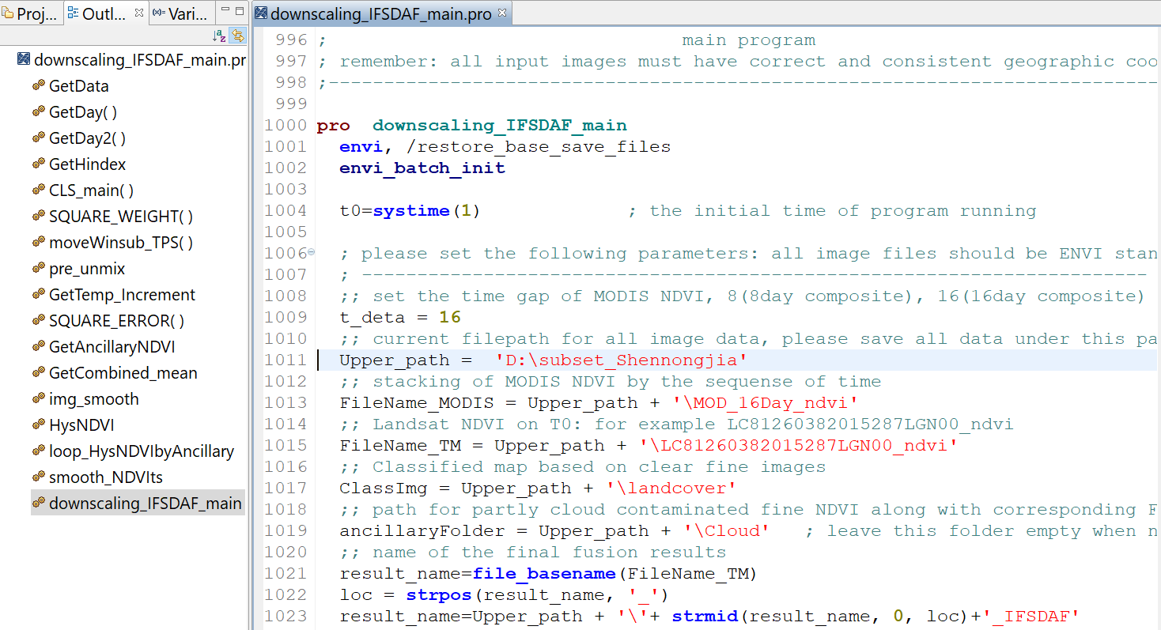
step1
Open IDL + classic ENVI (64bit), drag the code into IDL:

Slide 5
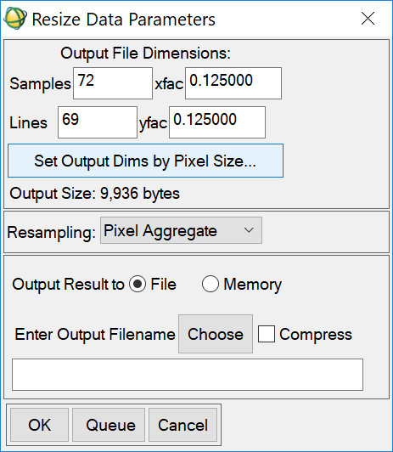
Step2
In ENVI or MODS tool: stack and resample all MODIS NDVI to 480 m (250 m data to 240 m) use nearest neighbor method and reproject MODIS to Landsat’s projection;
Resample Landsat NDVI to the same resolution of MODIS (480 m or 240m) using pixel aggregate method.

Slide 6
step3
Geo-rectified one MODIS image to the resampled Landsat:
Choose resampled Landsat as reference, correct MODIS.
Envi/map-registration/ select GCPs: image to image
The rule derived from GCPs applied to all MODIS images

Slide 7
step4
Crop MODIS NDVI time series by the original 30m Landsat NDVI, make sure the final MODIS data fully cover the Landsat region:
don’t resample MODIS data to 30 meters
Envi/File/save file as envi standard/import file-select MODIS image/spatial subset/file-select Landsat/ok
For the test data, we have done step2-step4!

Slide 8
P.S. !!!
After step 4, please check MODIS data fully cover the Landsat NDVI:
Landsat pixel
MODIS pixel
regular Landsat
irregular Landsat
irregular Landsat
✓
✓
×
Both regular shape and irregular shape will be good, but remember MODIS must fully cover Landsat!!!

Slide 9
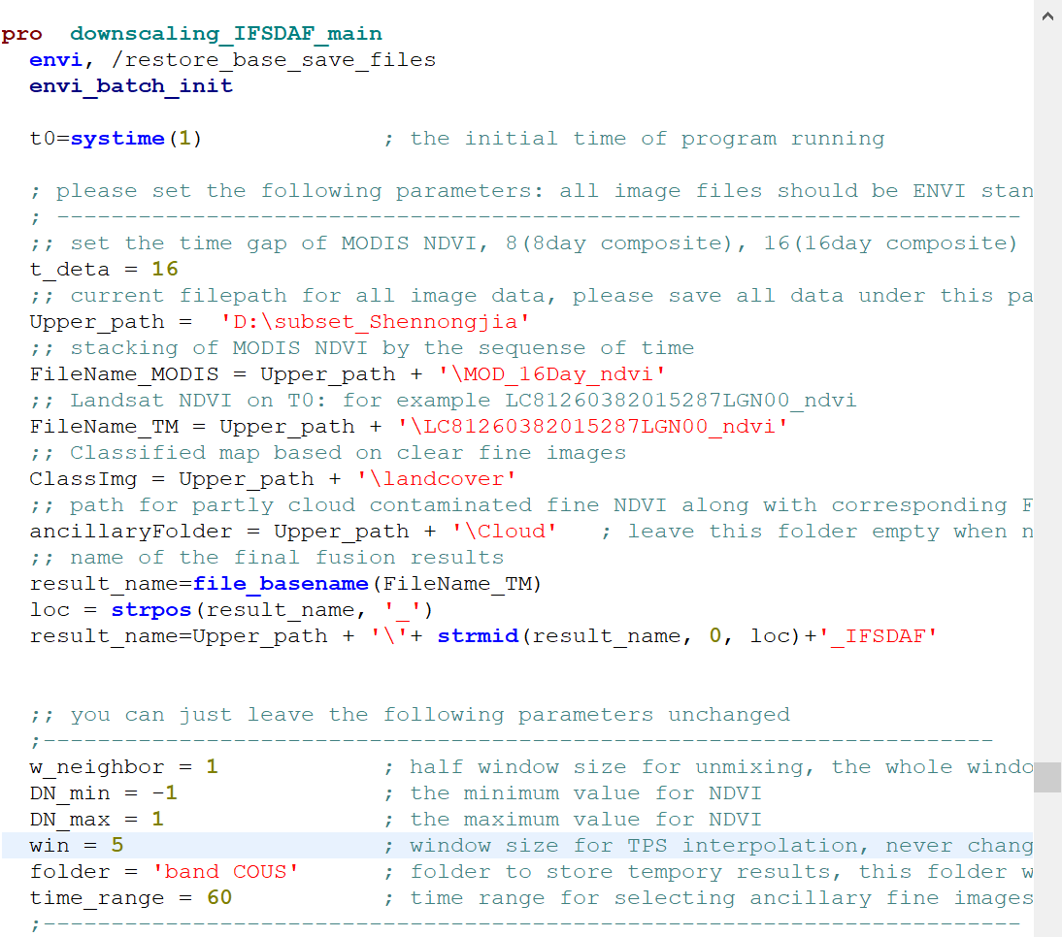
Step 5
Follow the explanation or the paper to set the parameters

Slide 10
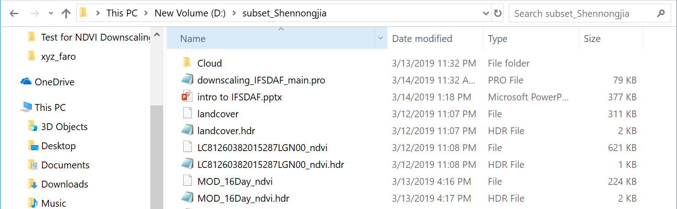
Upper_path = ‘D:\subset_Shennongjia’
All files are stored in this folder

Slide 11
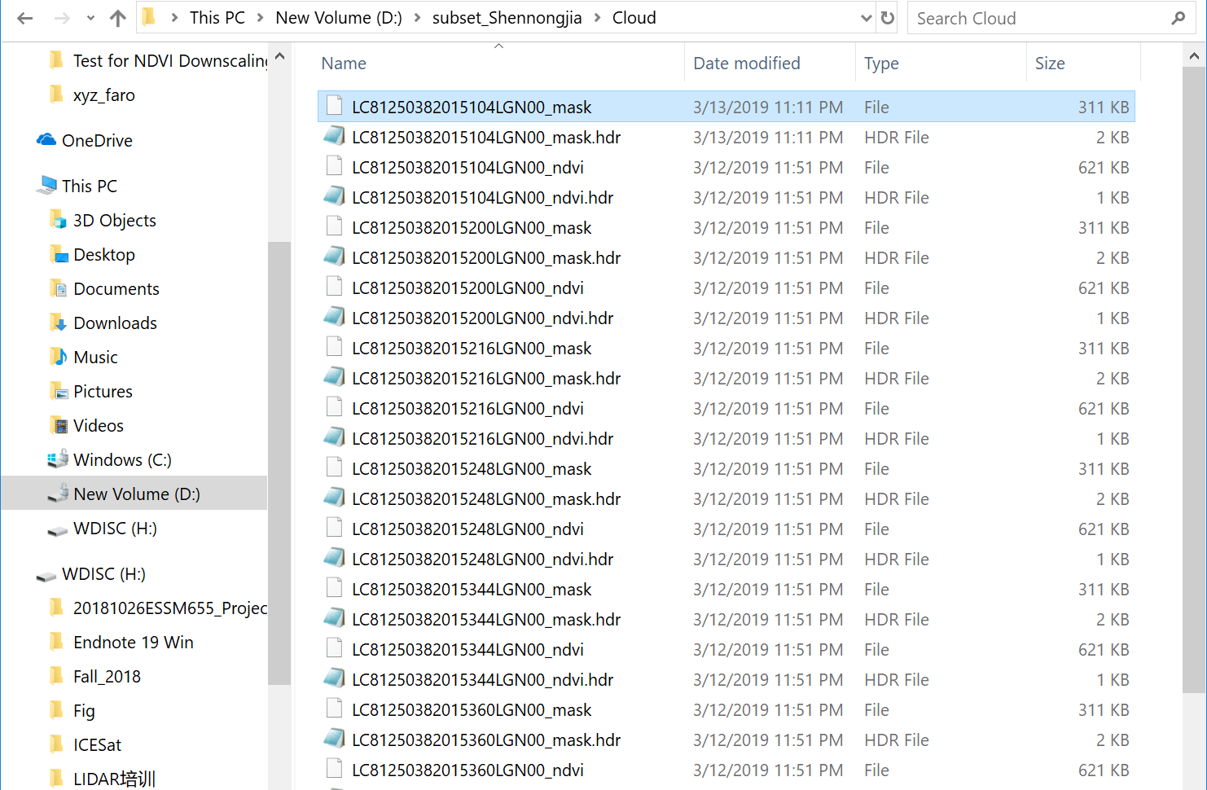
Ancillaryfolder= ‘D:\subset_Shennongjia\Cloud’
All partly contaminated Landsat NDVI and fmasks are stored in this folder

Slide 12
Step 6
Compile and run program:
IDL->run->compile & run…
the output fusion result is: LC81260382015287LGN00_IFSDAF,
LC81260382015287LGN00_IFSDAF.hdr

